Slide 1
Retail Sales Analysis SQL Project

Slide 2
Retail Sales Analysis
This project aims to showcase SQL skills and technique commonly used by data analysts for exploring, cleaning and analyzing retail sales data.
It includes setting up a retail sales database, conducting EDA, and addressing specific business questions through SQL queries.
This project is perfect for those beginning their data analysis journey and looking to establish a strong SQL foundation.

Slide 3
Objectives
Set up a retail sales database
Create and populate a retail sales database with the provided sales data.
Data Cleaning
Identify and remove any records with missing or null values.
Exploratory Data Analysis (EDA)
Perform basic exploratory data analysis to understand the dataset.
Business Analysis
Use SQL to answer specific business questions and derive insights from sales data.

Slide 4
Project Structure
Database Creation
The project starts by creating a database named retail_db.
Table Creation
A table named retail_sales is created to store the sales data.
The table structure includes columns for transaction ID, sale date, sale time, customer ID, gender, age, product category, quantity sold, price per unit, cost of goods sold (COGS), and total sale amount.

Slide 5
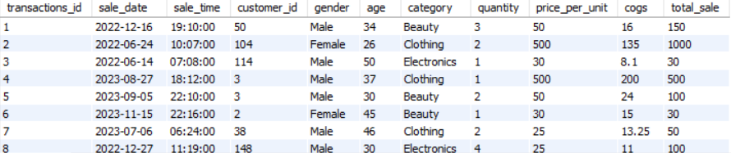
CREATE DATABASE retail_db;
CREATE TABLE retail_sales
(
transactions_id INT PRIMARY KEY,
sale_date DATE,
sale_time TIME,
customer_id INT,
gender VARCHAR(10),
age INT,
category VARCHAR(35),
quantity INT,
price_per_unit FLOAT,
cogs FLOAT,
total_sale FLOAT
);

Slide 6
Data Exploration & Cleaning
Record Count
Determine the total number of records in the dataset.
Customer Count
Find out how many unique customers are in the dataset.
Category Count
Identify all unique product categories in the dataset.
Null Value Check
Check for any null values in the dataset and delete records with missing data.

Slide 7
SELECT COUNT(*) FROM retail_sales;
SELECT COUNT(DISTINCT customer_id) FROM retail_sales;
SELECT DISTINCT category FROM retail_sales;
SELECT * FROM retail_sales
WHERE
sale_date IS NULL OR sale_time IS NULL OR customer_id IS NULL OR
gender IS NULL OR age IS NULL OR category IS NULL OR
quantity IS NULL OR price_per_unit IS NULL OR cogs IS NULL;
DELETE FROM retail_sales
WHERE
sale_date IS NULL OR sale_time IS NULL OR customer_id IS NULL OR
gender IS NULL OR age IS NULL OR category IS NULL OR
quantity IS NULL OR price_per_unit IS NULL OR cogs IS NULL;

Slide 8
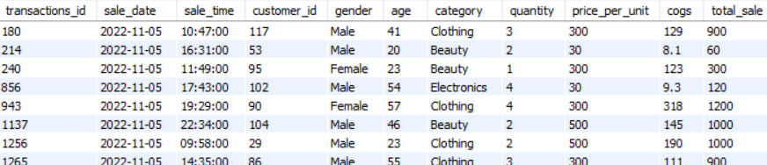
Data Analysis & Findings
Write a SQL query to retrieve all columns for sales made on '2022-11-05’.
SELECT
*
FROM
retail_sales
WHERE
sale_date = '2022-11-05';

Slide 9
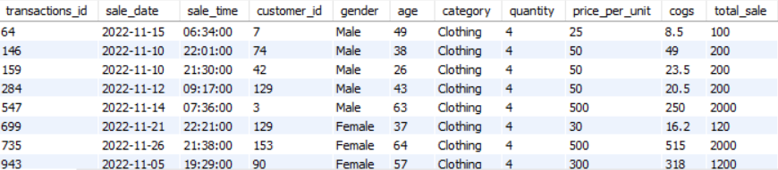
Write a SQL query to retrieve all transactions where the category is 'Clothing' and the quantity sold is more than 4 in the month of Nov-2022.
SELECT
*
FROM
retail_sales
WHERE
(Category = 'Clothing’ AND quantity >= 4)
AND sale_date BETWEEN '2022- 11-01’
AND '2022-11-30';

Slide 10

Write a SQL query to calculate the total sales (total_sale) for each category
SELECT
category,
SUM(total_sale) AS net_sale, COUNT(*) AS total_orders
FROM
retail_sales
GROUP BY
category;

Slide 11

Write a SQL query to find the average age of customers who purchased items from the 'Beauty' category.
SELECT
ROUND(AVG(age), 2) AS avg_age
FROM
retail_sales
WHERE
category = 'Beauty';

Slide 12
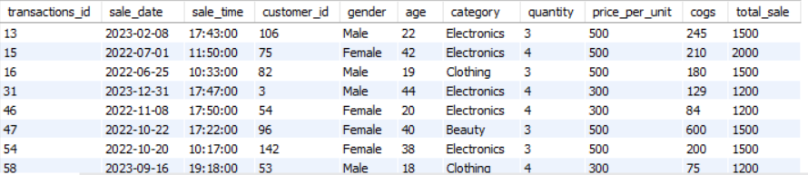
Write a SQL query to find all transactions where the total_sale is greater than 1000.
SELECT
*
FROM
retail_sales
WHERE
total_sale > 1000;

Slide 13
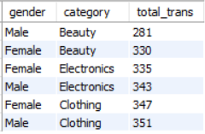
Write a SQL query to find the total number of transactions (transaction_id) made by each gender in each category.
SELECT
gender,
category,
COUNT (transactions_id) as total_trans FROM
retail_sales
GROUP BY
gender , category
order by
total_trans;

Slide 14
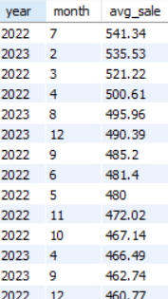
Write a SQL query to calculate the average sale for each month. Find out best selling month in each year.
SELECT
YEAR(sale_date) AS year,
MONTH(sale_date) AS month, ROUND(AVG(total_sale), 2) AS avg_sale
FROM
retail_sales
GROUP BY
year , month
ORDER BY
avg_sale DESC;

Slide 15
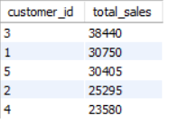
Write a SQL query to find the top 5 customers based on the highest total sales
SELECT
customer_id,
SUM(total_sale) AS total_sales
FROM
retail_sales
GROUP BY
customer_id
ORDER BY
total_sales DESC
LIMIT 5;

Slide 16

Write a SQL query to find the number of unique customers who purchased items from each category.
SELECT
category,
COUNT(DISTINCT customer_id) AS unique_customers
FROM
retail_sales
GROUP BY
category;

Slide 17

Write a SQL query to create each shift and number of orders (Example Morning < 12, Afternoon Between 12 & 17, Evening > 17).
WITH hourly_sale
AS
( SELECT *,
CASE
WHEN EXTRACT(HOUR FROM sale_time) < 12 THEN 'Morning'
WHEN EXTRACT(HOUR FROM sale_time) BETWEEN 12 AND 17 THEN 'Afternoon'
ELSE 'Evening'
END as shift
FROM retail_sales
)
SELECT shift, COUNT(*) as total_orders
FROM hourly_sale
GROUP BY shift;

Slide 18
Reports
Sales Summary
A detailed report summarizing total sales, customer demographics, and category performance.
Trend Analysis
Insights into sales trends across different months and shifts.
Customer Insights
Reports on top customers and unique customer counts per category.

Slide 19
Conclusion
The project provides a thorough introduction to SQL for data analyst, encompassing database setup, data cleaning, exploratory data analysis, and business focused SQL queries.
Insights from this project can support business decisions by revealing sales trends, customer behavior and product performance.

